Slide 1
Topic – Understanding the Resale Market of the hdb flats
Name – Nyan Hein
Student ID - 2340911

Slide 2
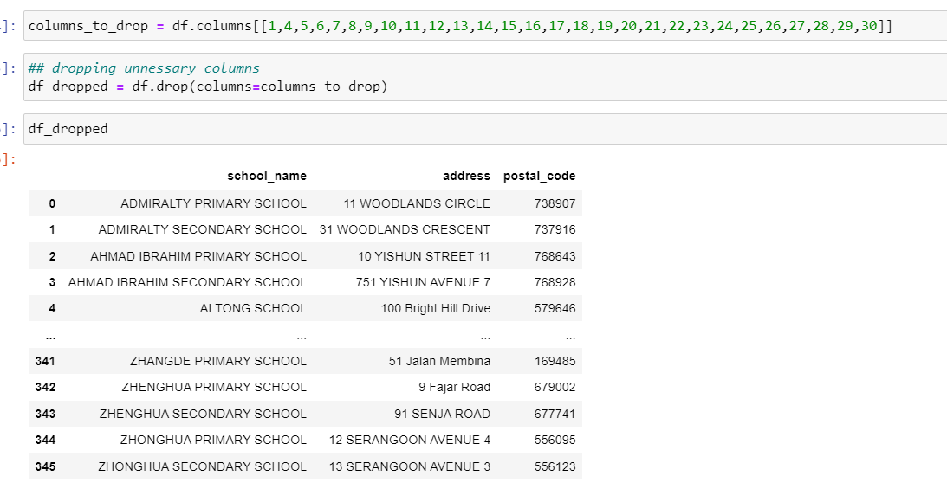
Datasets Used and Data Wrangling
Generalinformationofschools.csv(https://beta.data.gov.sg/collections/457/datasets/d_688b934f82c1059ed0a6993d2a829089/view)
The above data set is used to observe the distribution of schools and the resale price in those regions.
Data Dictionary – This data set contains 346 rows and 31 columns(school name, postal code, telephone no, president name, and many unnecessary data for my analysis. So I dropped or removed these columns using python. This data set is combined with HDB resale prices data set in tableau.
Only school name, address and postal code columns are left.
ResaleTransactionsbyFlatTypebasedonregisteredcases.csv(https://beta.data.gov.sg/datasets/d_27af98d638a80103319cb7499c220fe6/view)
This data set is used to analyse which flat types are mostly sold. This data set contains number of resale transactions made for different flat types in the years from 2016 to 2021.

Slide 3
Two more datasets(GDP and unemployment rate are used and combined)
GrossDomesticProductInChained2015DollarsByIndustrySSIC2020Quarterly.csv(link - https://beta.data.gov.sg/datasets/d_87a41037716428a042305df9b948ece2/view) (This data set contains the GDP of Singapore from 1975 to 2023 quarterly for different industries(including the total GDP). This data set is used to observe the GDP of Singapore over time and analyse it with the Resale Prices.
ResidentLongTermUnemploymentRateAnnual.csv(link - https://beta.data.gov.sg/datasets/d_f095d1e91b1c66d11ce3db70c0c924fd/view) This data set contains the unemployment rate of residents in Singapore from 1992 to 2023. This data set is used to observer the unemployment rate of Singapore over time and analyse the Resale Prices.
Data Wrangling of these two data sets
Getting the total GDP
Melting the data set(columns to rows)
Changing the data type to numerical values
Getting the year column
Aggregating the GDP by summing up to get the total GDP of a particular year
Filtering the data from 1990 to 2023
Merging the unemployment data set and GDP data set

Slide 4
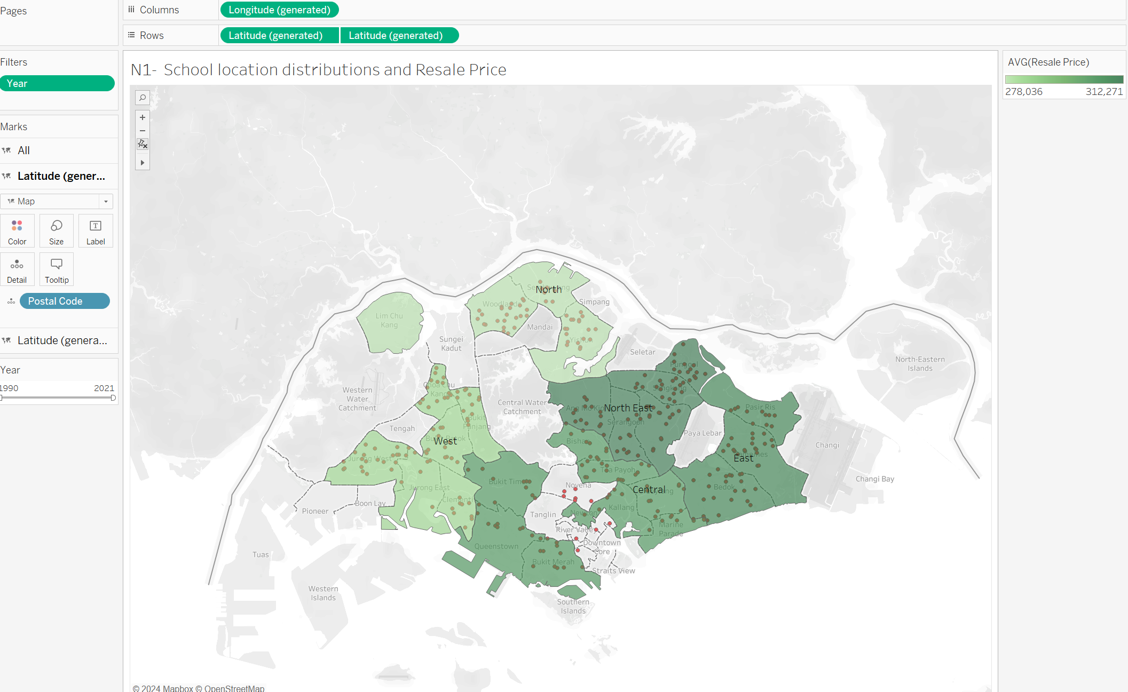
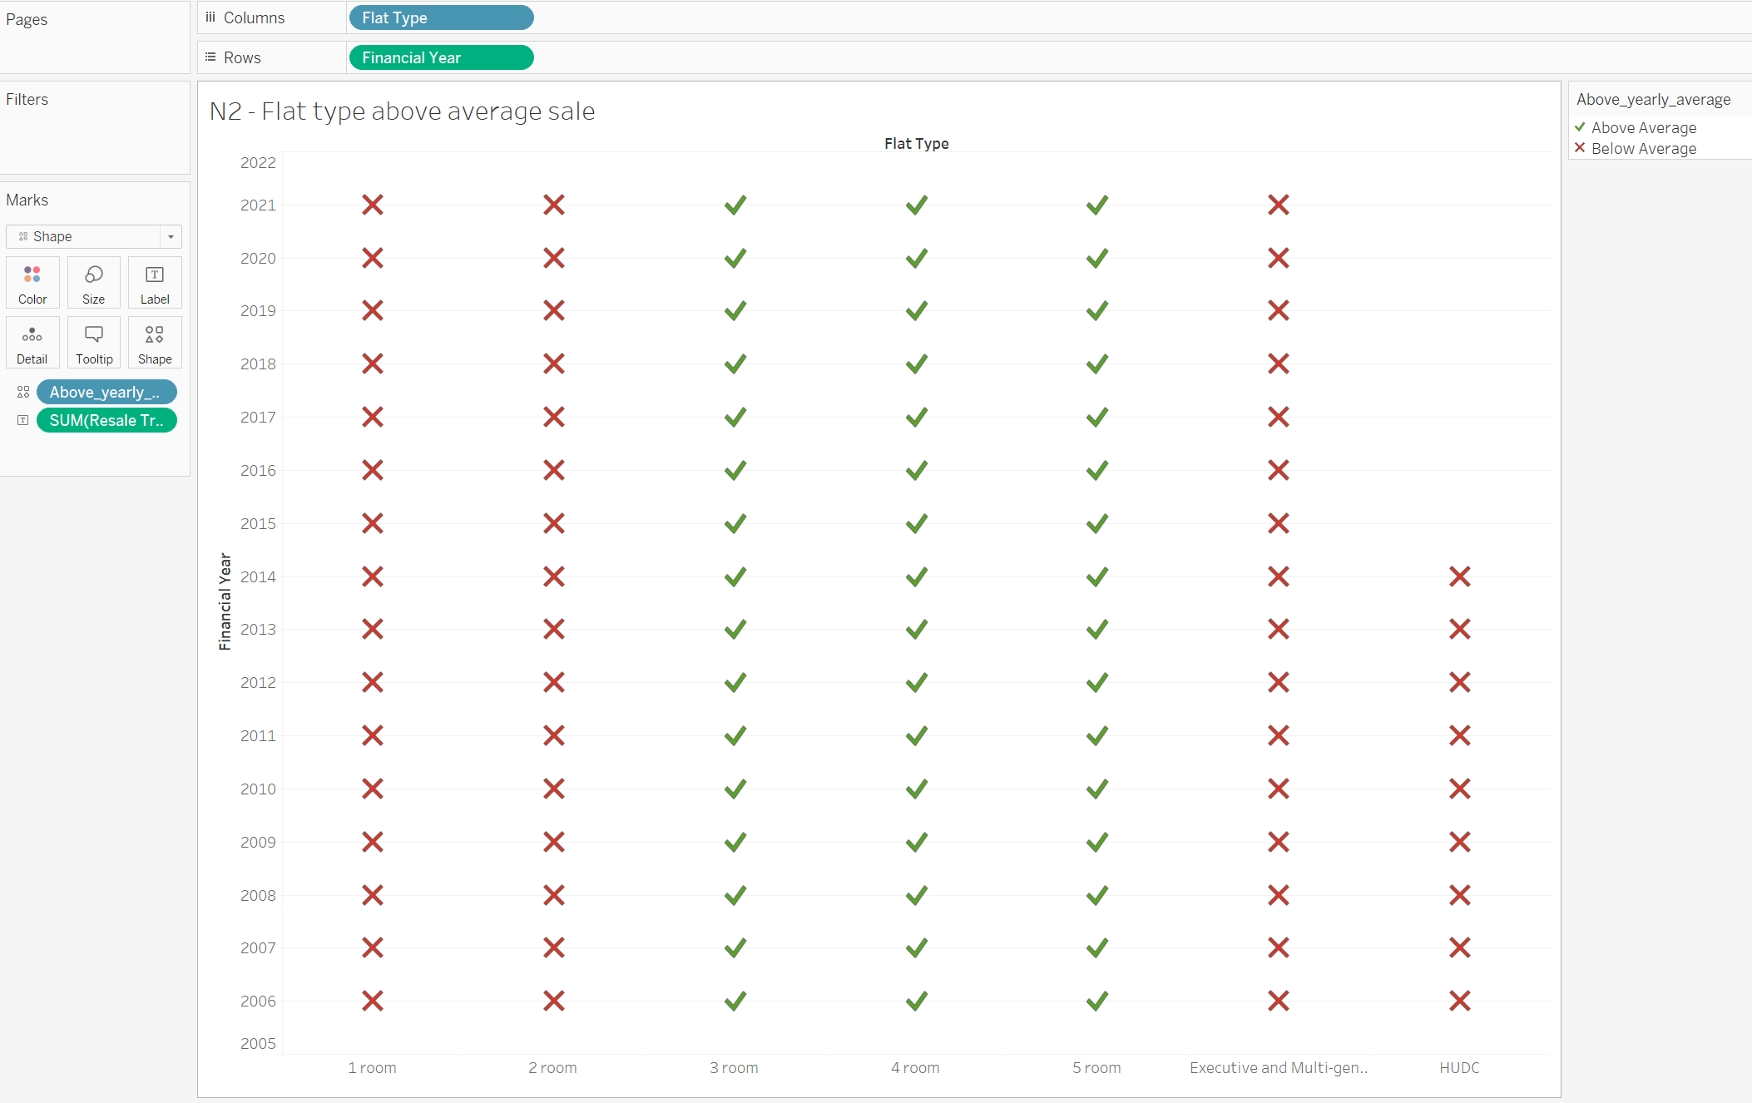
Objective 1 – Analyzing how other factors (school distribution, area square meters) are affecting Resale Price
From the above visual, it can be clearly seen that the 3 floor, 4 room and 5 room flat types are the best-selling flat types.
From the above map, the distributions of the schools are a little denser in the North-East and East region on the resale price and the prices are also higher in those regions.

Slide 5
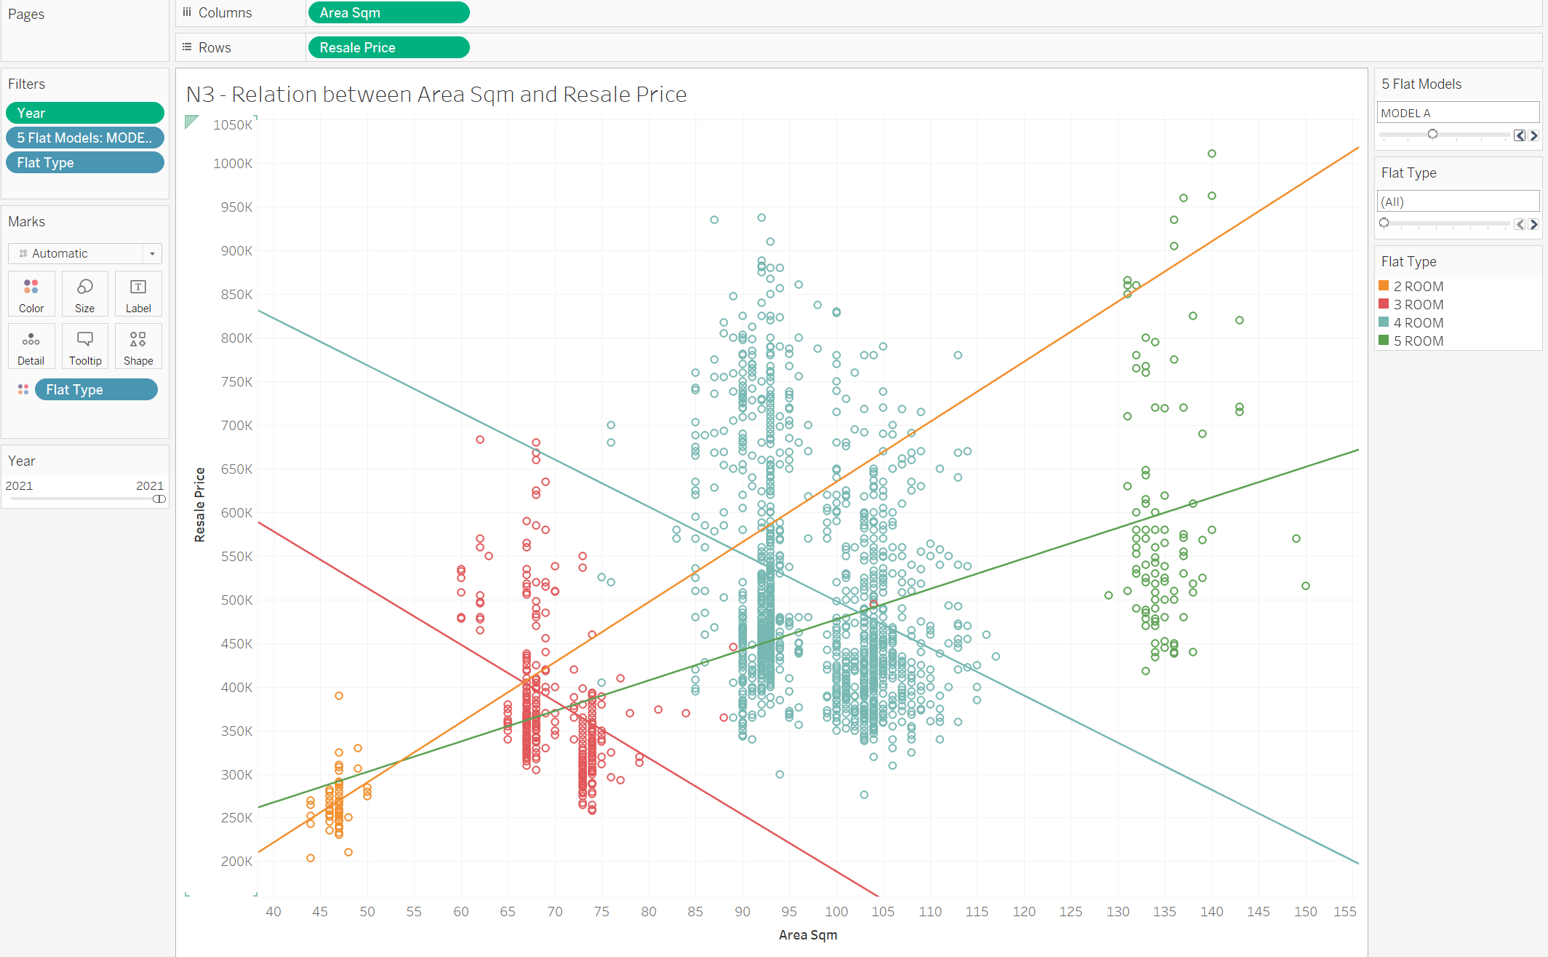
Relation between Area square meter and Resale Price
For some flat types in some flat models, there is some negative relation, for example in model A flat model, 4 room and 3 room flat types have negative trend lines.
So, this means a buyer can have a larger flat with a low price for the same particular flat type of flat model.

Slide 6
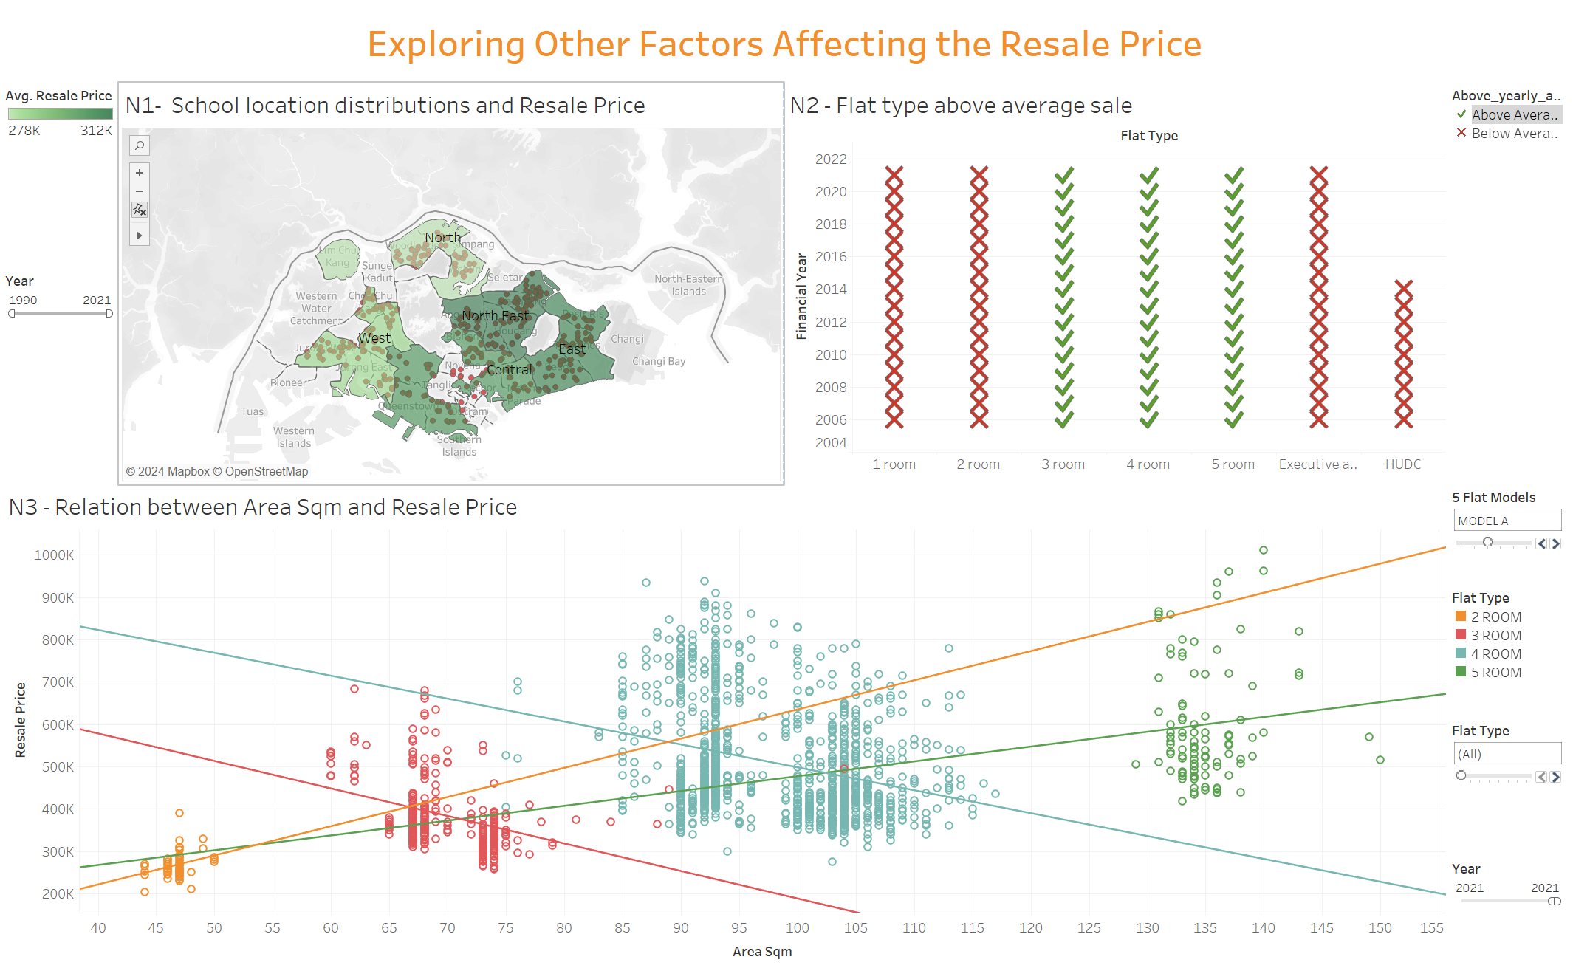
First Dashboard
From this dashboard, one can see how the factors(area square meter, school location distributions) affect the Resale price and one can also see which flat types are the best-selling ones.

Slide 7
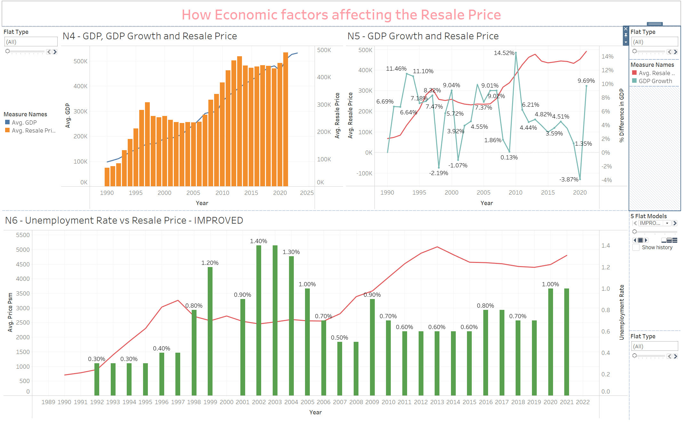
Objective 2 – How Economic factors are affecting the Resale Price
Generally, from the given graph, the trend of the GDP increases over time and the Resale price also increases.
From analyzing the graph, whenever the GDP growth is down(becomes minus) the resale prices also decreases.
The Resale Prices tends to decreases when the unemployment rate decreases. For example, between 1998 and 2006 when the unemployment rate is highest, there is a decreasing curve of resale price after that period when the unemployment rate becomes low, the resale price increases again.
From the above second dashboard, one can easily analyze how the economic factors(GDP, GDP growth and Unemployment rate) affect the resale prices of different flat types of different flat models.

Slide 8
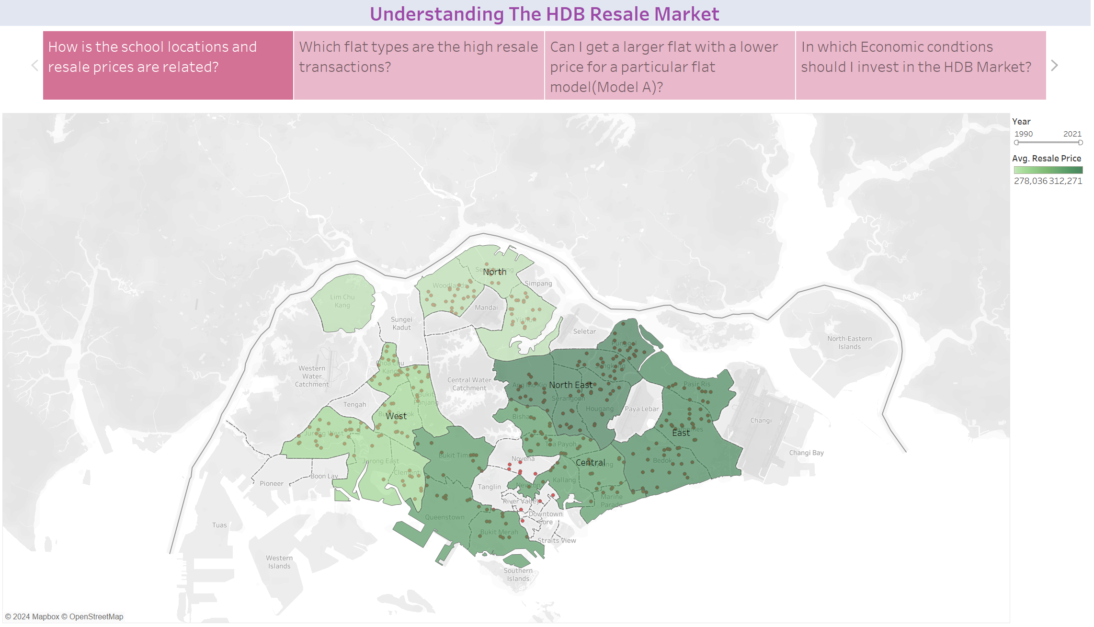
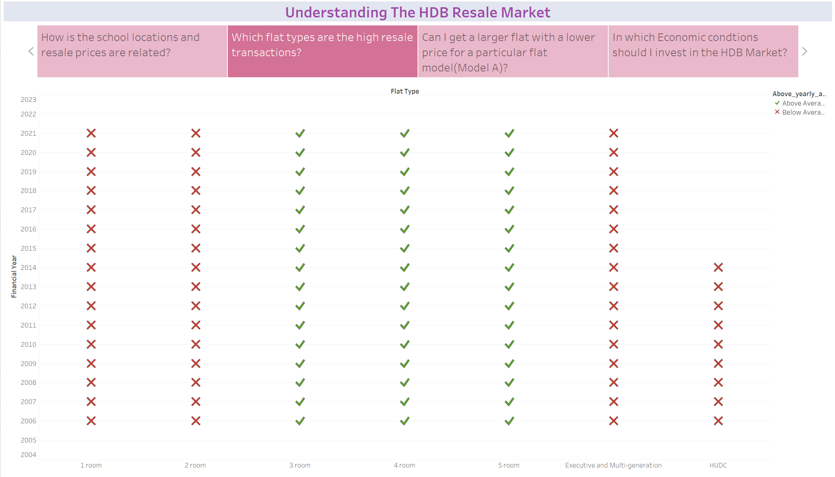
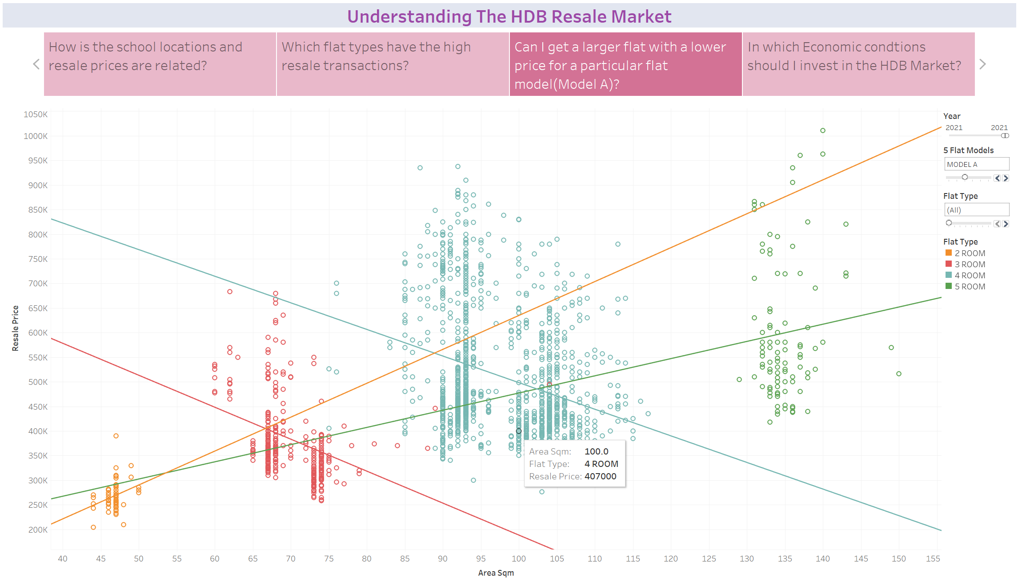
Crafting A Data Story
Title – Understanding the Resale Market of the HDB flats
An investor investigates how school locations(distributions affect the resale prices) and he found that in Northeast and East Region, where the number of schools is higher compared to Wes and North, the prices are also high. So, the investor understands the price tends to higher in regions where the number of school are high.
First Story Point - How is the school locations and resale prices are related?
Second Story Point – Which flat types have the high resale transactions?
Now, diving deeper, the investor wants to know which kinds of flat types have the high resale transactions. 3-Room, 4-Room and 5-Room flat types have high transactions.
So, now the investor is interested, whether he/she can get the larger flat with a lower price, for a particular flat model. In the graph shown, for the flat model A there are certain flats that have higher square meters, with the lower price.
Story Point 3 – Can I get a larger flat with a lower price for a particular flat model( for example model A)?

Slide 9
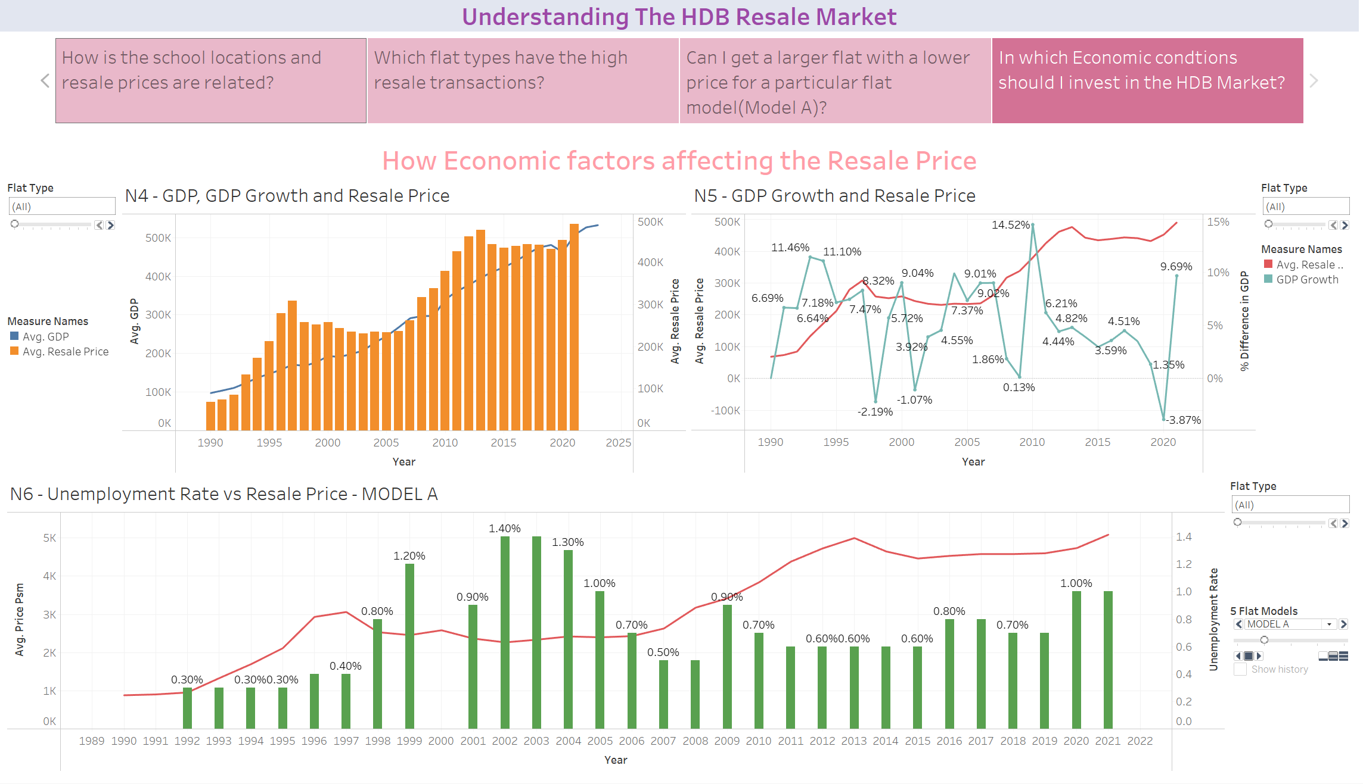
Story Point 4 - In which Economic conditions should I invest in the HDB Market?
From the trends, Generally when the GDP becomes high, the resale price also increases. But from the point of view of GDP growth, when there is minus GDP growth, and the economy is not good, the resale prices drops. And when the economy is good again, the price increases again. The same pattern can see for the unemployment rate too. So, the investor should buy the flats when the economy is down.

Slide 10
Conclusion
From the understanding of the market of the HDB resale, the investors can make the informed decisions. For example, if the investor knows that the price of the HDB will become high if the new schools are going to be built around the area and they can also know which kinds of flat types can buy and sell easily(high resale transactions) and they can also know that they can find and buy the larger flats with lower price for the same flat model and type and they can also know that in which kinds of economic conditions, they should buy the HDB.
Recommendations that could help Singapore to make improvements on housing
From the analysis, the condition of economy has some effect on the resale price. Singapore can make some adjustments to prevent the steep decline in resale price during economic downturns. Housing Grants, income tax relief and property tax relief can help people to afford the HDB flats which increases the demand of HDB flats and preventing the price drop.
2. Another finding is that there is a high demand in 3 room, 4 room and 5 room flat types compared to other flat types. So, Singapore should have policies in housing projects. For example, in the housing projects, there should be a variety of flat types, in each project. In a project, the number of 3 Room, 4 room and 5 room flat types should be higher to fulfill the demand of these flat types.

